Slide 1
ENSE 496ab
Milestone 2
MudsnakeFC
Xiaojie Chen, Connor Meredith, Zain Chowdhary, Jinpeng Chen, Demitri Kourles, Shuaihao Zhao
Oct. 11, 2018

Slide 2
Team introductions
Team members
  Xiaojie Chen, Connor Meredith, Zain Chowdhary, Jinpeng Chen, Demitri Kourles, Shuaihao Zhao
Team name
  Mudsnake FC

Slide 3
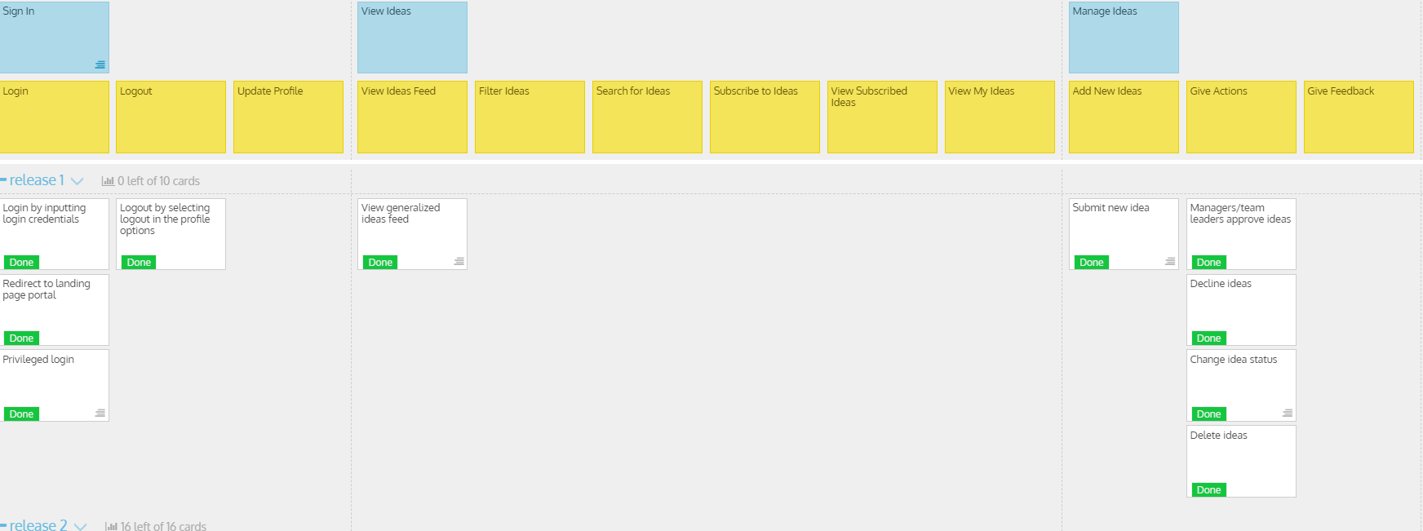
USM review (release 1)

Slide 4
USM review (release 1)
  What was envisioned?
    We expect to achieve the log in and log out functionalities for users, and users also have the ability to manage these ideas such as submitting ideas, deleting ideas etc.
  Did things stay the same or change?
  We stick to our previous plan so we stay the same.
  Rationalize your MVP
  As the first release of the project, we'd like to make sure that
  users can have an clear idea about the application so we choose to achieve the log and basic idea management functionalities first.

Slide 5
USM review (release 1)
Discuss time management
We communicate through WhatsApp, and devide the team to two part, one part contributes coding the project and the other one will keep updating the documentation. We also arrange some meetings after class if there are some questions.

Slide 6

MVP/Sprint-1 Demo

Slide 7
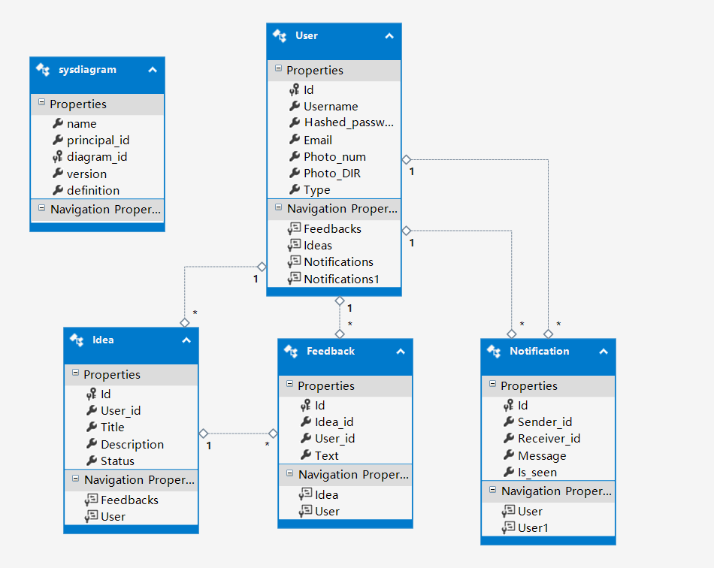
MVP/Sprint-1 Demo

Slide 8
Comments/Discussion
Successes
Team environment is good. Everyone is glad to help each other if people have troube understanding the project.
Barriers to success
It's hard to divide the work to all six people, but we'll find a way to deal with it.

Slide 9
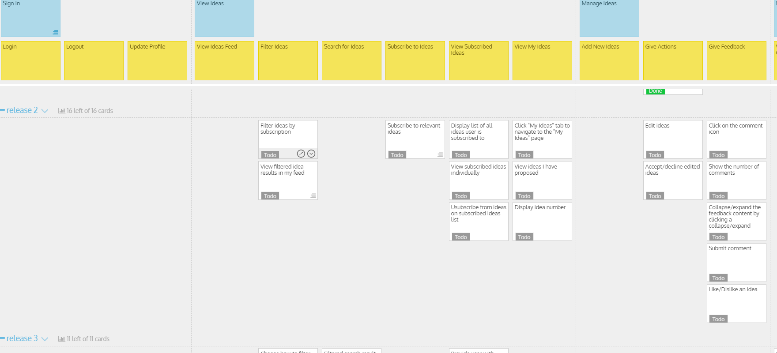
USM for MVP/Sprint-2

Slide 10
USM for MVP/Sprint-2
Address key deliverables/revisions
In this sprints, we'll add more functionalities about the viewing ideas part and also update the idea management for users.
Address and rationalize why the MVP/Sprint-2 can be considered as such
After the release one, users may have the general idea about this application, so we decide to update more elements about viewing and managing ideas so that users can get deeper understanding about how this application works.

Slide 11
Group reflection
How did you feel about this milestone? What did you like about it? What did you dislike?
This milestone is straightforward. Some team members have experiences about ASP.NET, and that reduces the difficulty of the project.
What did you learn about yourself as you collaborated and worked through this milestone?
Different people have different strengths so that team members can learn each other to improve themselves.
How will you use what you have learned going forward?
Keep learning and collaborating as a team may guide us to the right direction.
What“stuff & things" related to this milestone would you want help with?
Nothing much as we did not need to make major changes to the initial plan.

Slide 12
Questions?

